Slide 1
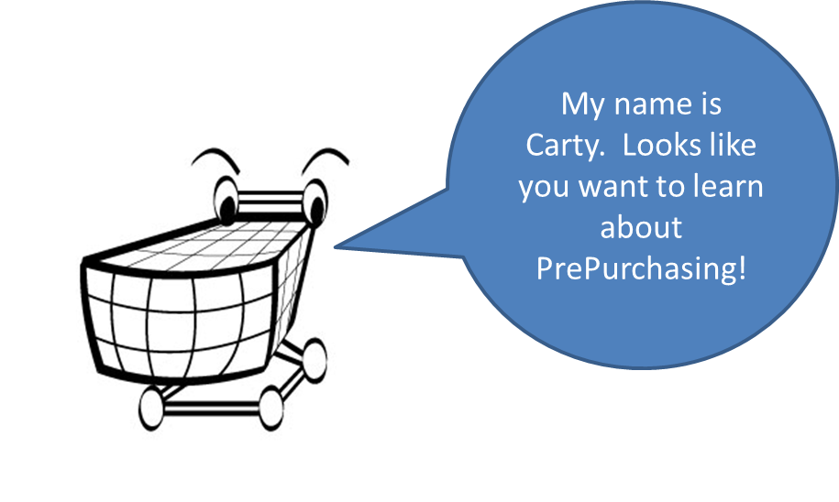
Overview
CA&ES Dean’s Office, Computing Resources Unit

Slide 2
Instructors
Jason Sylvestre
Alan Lai

Slide 3
Agenda
Permissions
Workgroups
Organizations
Feedback / Support
Mailing Lists
Demo

Slide 4
Permissions
Departmental Admin
Granted access to Organizations and Sub Organizations
Maintain Workgroups
Maintain some Organization level settings
For a workgroup
You, as a departmental admin grant these permissions.
Requester
Approver
Account Manager
Purchaser
Reviewer

Slide 5
Workgroups
What is a workgroup?
A way of organizing permissions, orders, and settings
Has a primary organization
Contains users with various permissions
Default
Vendors
Accounts (May sync with DaFIS)
Shipping Addresses
May have conditional approvals
3 Types of workgroups
Normal
Administrative
Full Featured Administrative

Slide 6
Workgroups Cont.
Tool to help with deciding workgroups
http://ucdavis.github.com/Purchasing/workgrouptool.html
* http://ucdavis.github.com/Purchasing/faq.html#workgroupoptions

Slide 7
Organizations
We grant you access to Organizations, and the related sub organizations
When we grant Departmental Admin access we will notify existing DA’s that may be effected (Parent and Child Orgs)
May have Organization Level Conditional Approvals
May have custom fields
Grants access to workgroups

Slide 8
Feedback and Support
Check the FAQ:
Before submitting a help desk ticket
https://ucdavis.uservoice.com/forums/126891-purchasing
Problems:
Issues not resolved with the FAQ
Help Desk Ticketing
Suggestions:
Ideas for improving the system

Slide 9
Mailing Lists
All departmental admins:
Opp-admins@ucdavis.edu
Subject starts with : [opp-admins]
All users including departmental admins:
Opp-users@ucdavis.edu
Subject starts with : [opp-users]
Used for notifications
System upgrades / downtimes
Reminder of resources like FAQ’s or changes to procedures

Slide 10

Questions?
Demo time!

